Slide 1
Lecture #15 :
Inheritance – Extending classes (contd...)
COMP 116: Object Oriented Programming
Presented by:
Roshan Manjushree Adhikari
Kathmandu University
27th June, 2018

Slide 2
Ambiguity resolution (contd...)

Slide 3
#include<iostream>
using namespace std;
class parent
{
public:
void display()
{
cout << "A\n";
}
};
class child : public parent
{
public:
void display()
{
cout << "B\n";
}
};
int main()
{
parent p;
child c;
p.display(); //calls version in parent class
c.display(); //calls version in child class
c.parent::display(); //calls version in parent class
c.child::display(); //calls version in child class
}

Slide 4
Hierarchical Inheritance
Students
Arts
Engineering
Medical
Mech.
Elec.
Civil

Slide 5
Hybrid Inheritance

Slide 6
Virtual base class
A second solution to resolve ambiguity in inheritance.
When a class is made a virtual base class, C++ takes necessary care to see that only one copy of that class is inherited, regardless of how many inheritance paths exist between the virtual base class and a derived class.

Slide 7
Class A
display()
Class B
Class C
Class D
d.display(); //compiler gets confused

Slide 8
class A //indirect base class
{
.....
};
class B : virtual public A
{
.....
};
class C : virtual public A
{
.....
};
class D : public B, public C
{
... //only one copy of A is inherited
};
Solution !!!

Slide 9
Abstract class
Cannot instantiate an object.
Sometimes implementation of all function cannot be provided in a base class because we don’t know the implementation.
Just acts as a base class (to be inherited by other class).
One or more methods are declared but not defined.
All derived class of abstract class should compulsorily implement the method.
A class that is not abstract is called concrete class.

Slide 10
Abstract class (contd...)
A pure virtual function (or abstract function) in C++ is a virtual function for which we don’t have implementation, we only declare it.
A pure virtual function is declared by assigning 0 in declaration.
A class is abstract if it has at least one pure virtual function.
We can have pointers and references of abstract class type.
If we do not override the pure virtual function in derived class, then derived class also becomes abstract class.
An abstract class can have constructors.

Slide 11
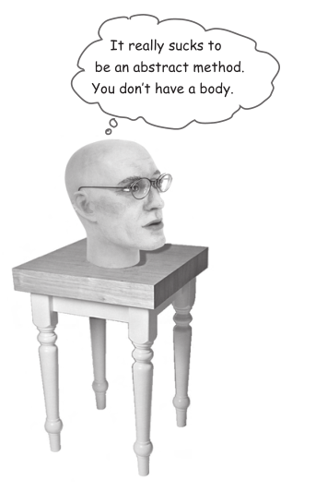
You MUST implement all abstract methods

Slide 12
Animal
abstract
abstract
Canine
abstract
Hippo
Feline
Cat
Wolf
Lion
Dog
Tiger

